Slide 1
Strategic & Tactical Implementation & Analysis Techniques for Digital Analytics

Slide 2
THANK YOU

Slide 3
I Use Twitter @analyticsninja

Slide 4
STEP 1:
STRATEGY BEFORE
IMPLEMENTATION

Slide 5
Web Analytics: Definition
Digital Analytics Association:
Web Analytics is the measurement, collection, analysis and reporting of internet data for purposes of understanding and optimizing web usage.
Notes:
Emphasis my own.
Formerly WAA because now we live in a multidevice world and have apps.
Digital Analytics critical for measuring user behavior along all of the steps that a user takes towards conversion.
A fuller picture of how users interact with your website. Much more so that just a conversion snippet.
To put it simply, you cannot determine if you are successfully meeting your goals if you can’t measure them.

Slide 6
Strategy BEFORE Implementation
What are your goals as company?
How do those relate to the internet?
What are your KPIs?
How would you measure that with GA?
Write down your questions
Brainstorm what data would be useful
If you can conceive a question, you can probably track it and answer it in GA.
http://www.analyticspros.com/blog/google-analytics/web-analytics-planning-model/
Notes:
We’re going to see in this presentation that Google Analytics doesn’t do a great job out of the box meeting a companies analytics need.
It is “not really” free software. Yes, the software license is free. It is a complex, powerful tool that needs to be implemented properly so that the data aligns with your business.
I’m not going to talk much in this presentation about what a strategic approach to analytics looks like. But I can’t proceed without stressing the importance of a strategic approach.
Take a look at Caleb Whitmore’s article. Think about the questions you see on the screen.
You should have internal resources dedicated to implementation and analysis or set aside some budget for outsourcing.
A proper web analytics process looks something like this….

Slide 7
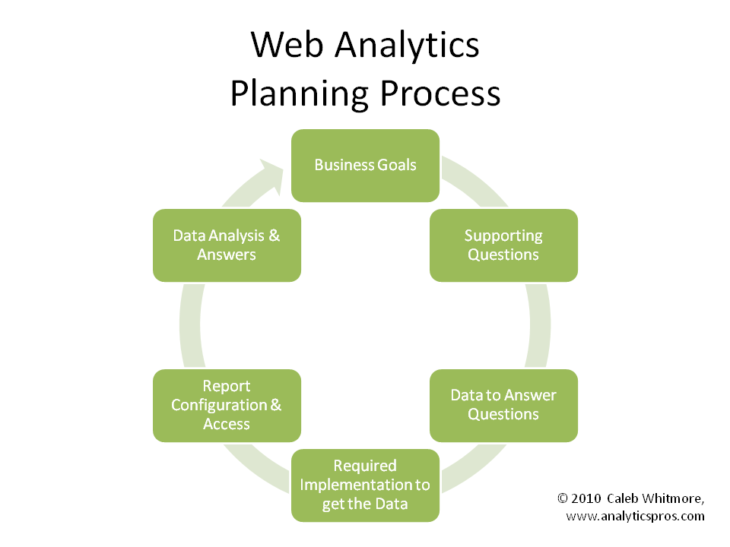
C/O
http://www.analyticspros.com/blog/google-analytics/web-analytics-planning-model/
Notes:
RELATIONSHIP BETWEEN ANALYTICS & CRO
CRO is trying to get more people to accomplish the goal of the site / business goals.
Analytics can identify areas of the site to test. Optimization of traffic sources, i.e. bring more relevant, higher converting visitors to your site.
Measure the impact of design changes on user behavior. Recently had a client approach me because they redid their website without putting robust analytics in first, just the vanilla copy and paste of the GA code, and without testing the changes as they went live. Conversion rate dropped and they are now stumped.
Before engaging in any sort of CRO, you’re going to want to have solid baseline analytics data.

Slide 9
Dimensions and Metrics are the building blocks of reports – KNOW THEM WELL

Slide 10
A dimension is a characteristic of an object that can be given different values —> a dimension describes data
A metric is an individual element of a dimension which can be measured as a sum or ratio —> a metric measures data
http://online-metrics.com/metrics-and-dimensions/

Slide 11
Custom Reports Allow You To Drill down to the good stuff
Notes:
This framework is not my own, rather it is a reframing of Avinash Kaushik’s Acquisition Behavior and Outcomes, which is more accurate, but I substitute the word conversion as it is the desired outcome, and a bit easier to remember the ABCs.
Benefit of Custom Reports is that you’ll be able to see a fuller view of your data in one place.
Two types – explorer or flat table. I almost always use the explorer because I can drill down into my data.
In this presentation, please pay particular attention to these custom reports and use them as a blue print for building your own.

Slide 12
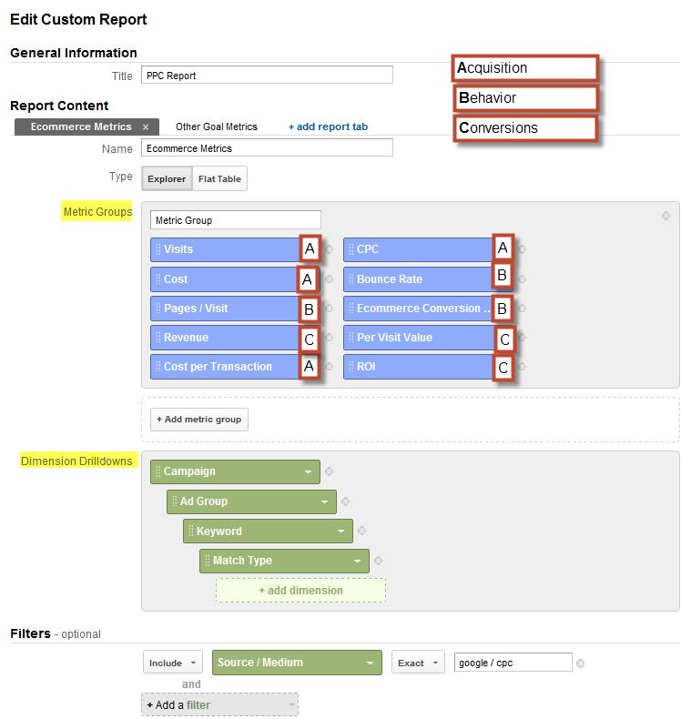
Custom Reports – The ABC’s
@analyticsninja
Notes:
This framework is not my own, rather it is a reframing of Avinash Kaushik’s Acquisition Behavior and Outcomes, which is more accurate, but I substitute the word conversion as it is the desired outcome, and a bit easier to remember the ABCs.
Benefit of Custom Reports is that you’ll be able to see a fuller view of your data in one place.
Two types – explorer or flat table. I almost always use the explorer because I can drill down into my data.
In this presentation, please pay particular attention to these custom reports and use them as a blue print for building your own.

Slide 13
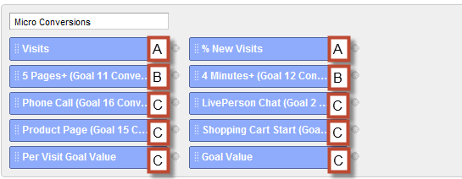
Add Micro Conversions On A Separate Tab (Metric Group)
@analyticsninja

Slide 14
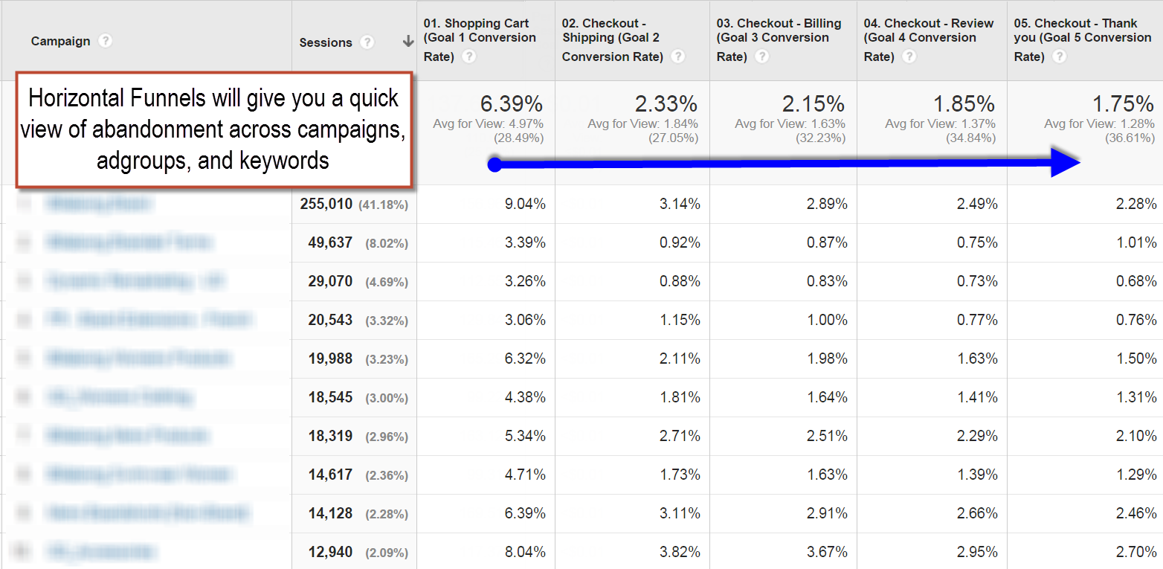
Configure Horizontal Funnels
@analyticsninja

Slide 15
Events vs. Custom Metrics

Slide 17
Custom Metrics can serve as event tracking on steroids

Slide 18
Custom Metrics can serve as event tracking on steroids

Slide 19
Track your top 10-15 actions with Custom Metrics

Slide 20
Track your top 10-15 actions with Custom Metrics

Slide 21
Calculated Metrics FTW!

Slide 22
Add Calculated Metrics to your custom reports for insights

Slide 23
Sort your metric to see categories with the highest level of interest

Slide 24
Add an advanced filter to surface categories with meaningful traffic volume

Slide 25
Add an advanced filter to surface categories with meaningful traffic volume

Slide 26
What do to next?
More prominent placement of those categories on the site (in recommended or featured content blocks)
Stronger keyword focus for paid and organic search
Test free sample buttons on those pages

Slide 27
Avoid Data Wandering via @tgwilson
I believe… [some idea about the site or channel]
If I am right, we will… [take some specific action]
http://www.practicalecommerce.com/articles/4106-Google-Analytics-How-to-Avoid-Data-wandering

Slide 28
STEP 2:
Be really clear about your #measure objectives.

Slide 29
Make sure you’re able to segment your content

Slide 30
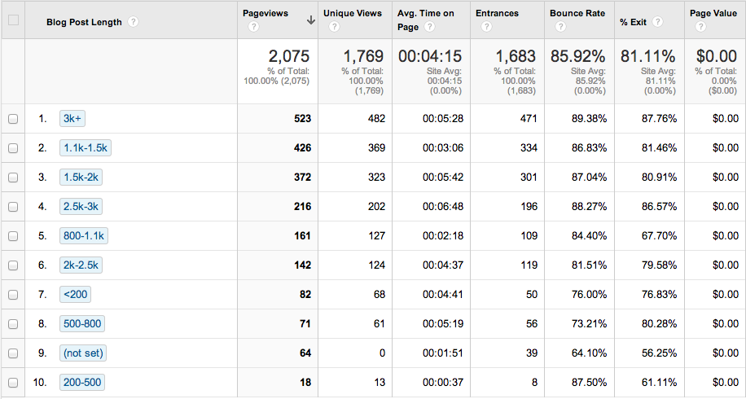
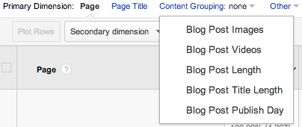
Use these as content groupings
www.lunametrics.com/blog/2014/01/24/classify-blog-posts-analytics-content-groupings

Slide 31
Look at broader business objectives over time
Notes:
If you don’t have a signed in user experience, take the clientId and pass as a value into the UserId.

Slide 32
Publishers have long term goals of increasing content consumption per user

Slide 33
It can be easy to get stuck in the “session” mud because of GA’s defaults

Slide 34
Use pan-session reports and user based analysis then find the segments that lead to money

Slide 35
Better than Time on Page / Site
Content Page Views per Session
Ad Revenue per Session
Number of shares / share rate
Download Rate
Poll Participation Rate
Video Play Rate
Social Follow Rate
Account Creation Rate
http://michele.webanalyticsdemystified.com/2013/09/better-ways-to-measure-content-engagement-than-time-metrics.html

Slide 36
Create Session Scoring
http://michele.webanalyticsdemystified.com/2013/09/better-ways-to-measure-content-engagement-than-time-metrics.html

Slide 37
Create Session Scoring
http://michele.webanalyticsdemystified.com/2013/09/better-ways-to-measure-content-engagement-than-time-metrics.html

Slide 38
STEP 3:
Segment, Segment, Segment, Segment, Segment, Segment, Segment, Segment, Segment, Segment, Segment, Segment, Segment, Segment, Segment, Segment, Segment, Segment.

Slide 39
Two Tiered Segmentation
Traditional visitor segmentation based on persona or relationship
Visit or unit-of-work based segmentation that is behavioral and is designed to capture the visit intent.
http://semphonic.blogs.com/semangel/2011/04/semphonics-two-tiered-segmentation-segmentation-for-digital-analytics-done-right.html
@garyangel

Slide 40
Customer Segmentation
Account creation date
Date of first purchase
Date of previous purchase
Count of Purchases (great for SaaS too)
Count of Items Purchased
Year of Birth
Gender
Email Subscriber
User Country
Customer Lifetime Value
Email Domain / Business Name
Industry

Slide 41
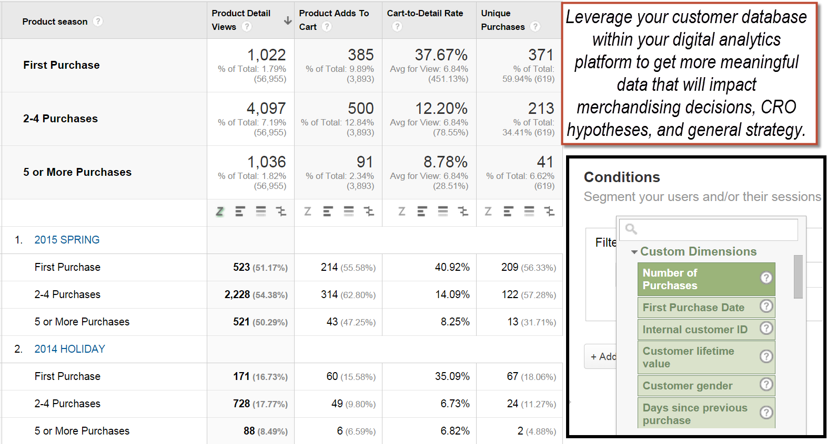
Customer Segmentation

Slide 42
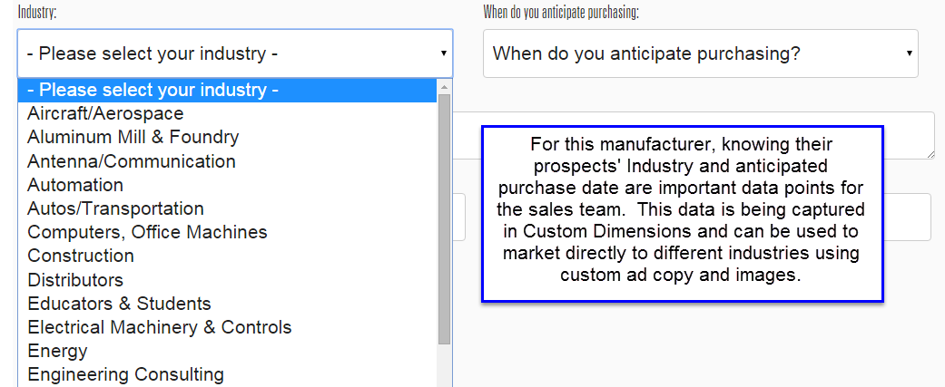
B2B Example

Slide 43
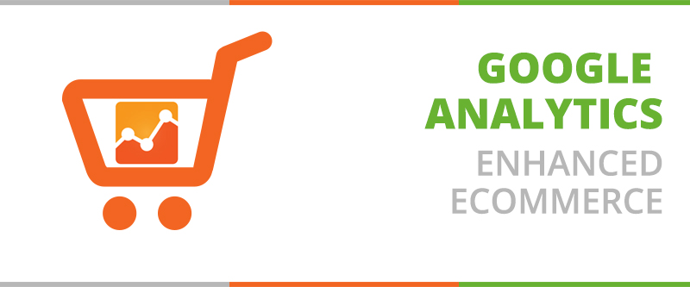
Notes:
Picture from: http://upwell.com.br/blog/google-analytics/google-analytics-lanca-nova-funcionalidade-para-ecommerce/

Slide 44
Enhanced Ecommerce models User Options & Decisions for products
Enhanced ecommerce provides us with visibility into the performance of “products”.
Impressions are meant to model the options the user has in front of them.
Actions are meant to model the decisions the user made.

Slide 45
Limited but still useful vocabulary in Enhanced Ecommerce
Product Impression
Product Click
Detail View
Add to Basket
Checkout
Checkout Option
Purchase
Refund

Slide 46
Use Product Level Custom Dimensions to enhance data
Product freshness
season / added to inventory date
Product level promotional descriptions
On sale, featured item, etc.
Current product stock amount
Product number of reviews
Product level profit margins
Product attributes such as color, size, weight, manufacturer, distributor, warranty

Slide 47
Product Dimensions vs. Metrics
Show me all product views that for products that have a profit margin of 40% or higher
CUSTOM DIMENSIONS
Show me the top 10 profit generating products
CUSTOM METRICS

Slide 48
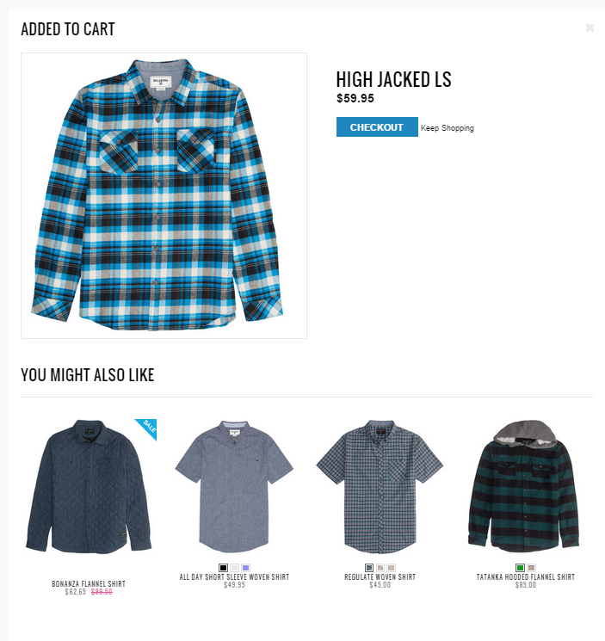
Measuring Cross sells

Slide 49
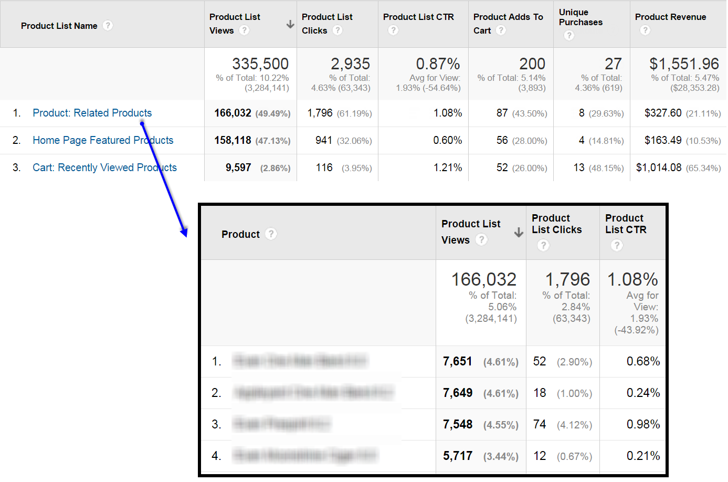
Google Analytics Enhanced Ecommerce

Slide 50
What do we do with it?
Cross Sell / Up Sell performance the most exciting aspect of product list “impression” data
Recommendation engine optimization
(via @fastbloke)
Insights regarding merchandising placement within category pages can be gleamed, though sales data is a stronger indicator of when to highlight products.

Slide 51
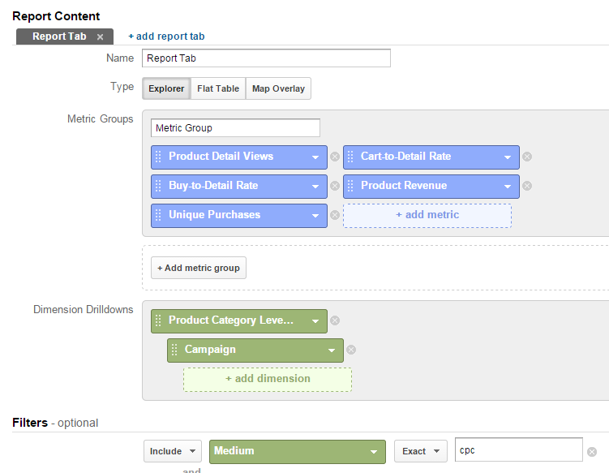
Propensity for Purchase Metrics ROCK

Slide 52
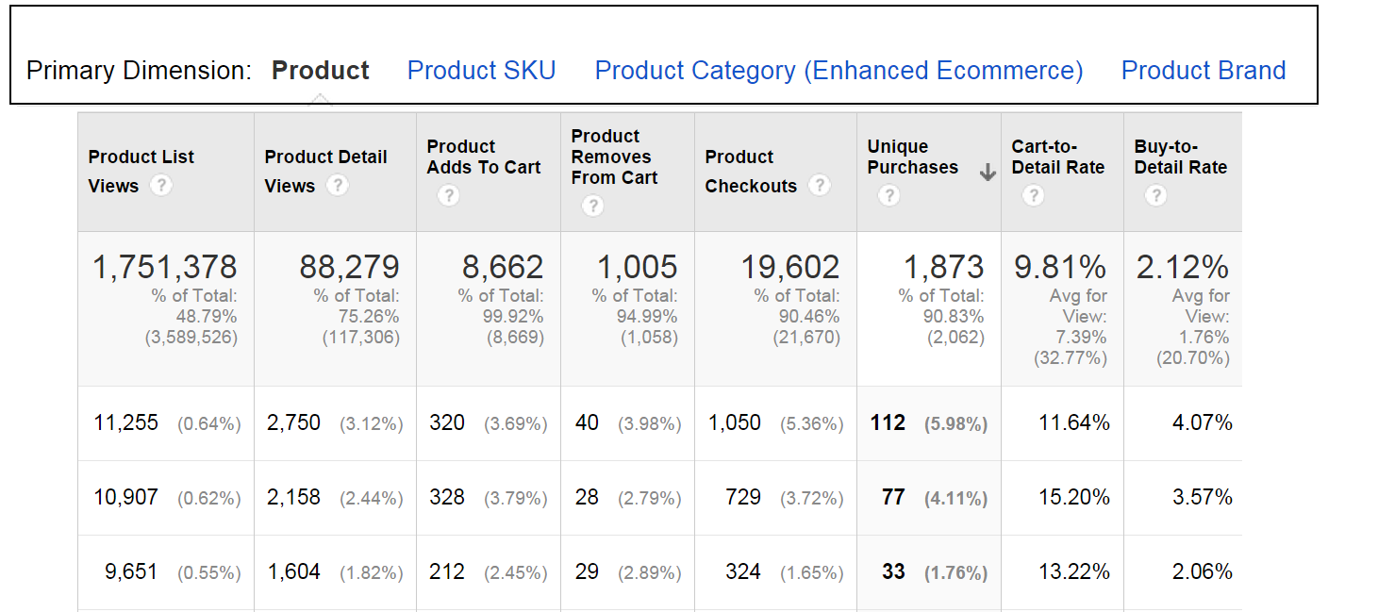
Product Performance Reports

Slide 53
Product Performance Standard Metrics
Big benefit of providing Cart to Detail and Buy to Detail Rates – many businesses wouldn’t be accessing those metrics. Propensity to purchase!
For now, those metrics are based on VIEWS instead of unique views, which I believe doesn’t model shopping behavior in the optimal way.

Slide 54
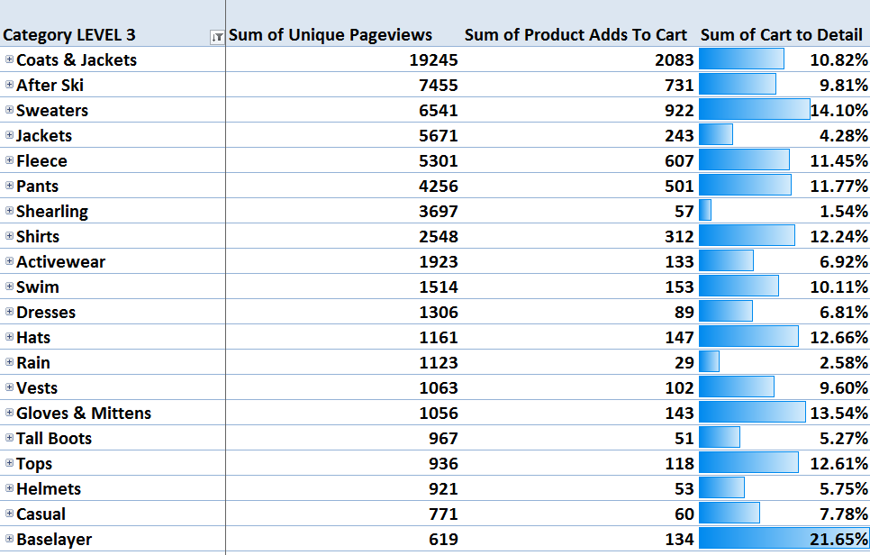
Calculated Cart to Detail

Slide 55
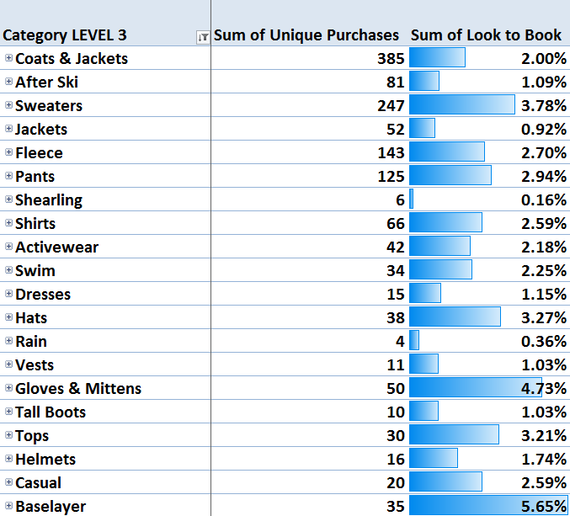
Calculated Buy to Detail Rate

Slide 56
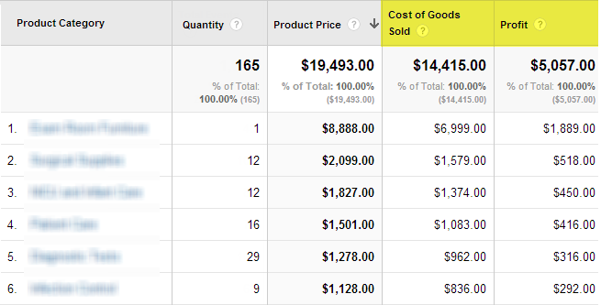
Use Profit Metrics
@analyticsninja

Slide 57
What do we do with it?
Advertise. Duh!
Product Listing Ads
Keyword bidding
Product placement on category pages and homepage splashes.
Help guide merchandising decisions

Slide 58
Smart Data Layer => Smart Decisions
Notes:
One of the most important aspects of determining the values that are passed to the data layer, are the companies business objective themselves. This business…. (explain what they do).

Slide 59
Smart Data Layer => Smart Decisions

Slide 60
Smart Data Layer => Smart Decisions
Notes:
Clear next step is to focus on acquiring traffic targeted the courses that have a higher propensity to lead to conversion.
Creating different funnel visualizations between Course Page > Registration Form, or course page to registration completion.
Web Dev and project management had a lot of people make it to the REG form but not complete the form.

Slide 61
STEP 4:
More segmentation

Slide 62
With analytics we measure specific actions (read: intent) taken at a specific times

Slide 63
With analytics we measure specific actions (read: intent) taken at a specific times

Slide 64
Hit Level Segmentation is possible in Google Analytics when you use sequence based segments
@charlesfarina

Slide 65
Dimensions + Metrics #measure intent

Slide 66
Dimensions + Metrics #measure intent

Slide 67
Dimensions + Metrics #measure intent

Slide 68
Intent, Intent, Intent

Slide 69
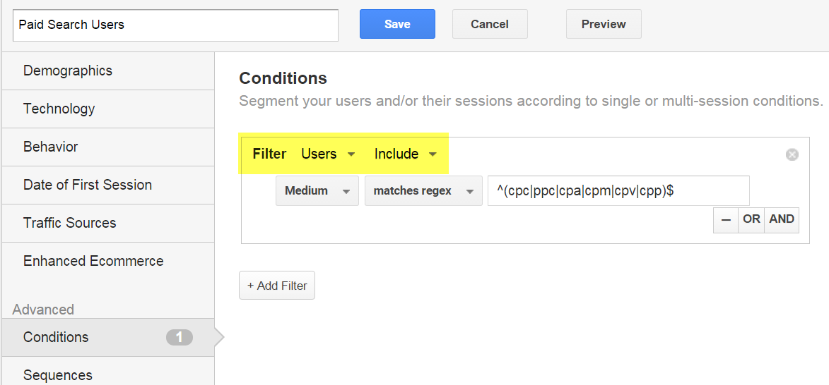
USERs Not Sessions
@analyticsninja

Slide 70
Apply This Segment to ANY Report
@analyticsninja

Slide 71
STEP 5:
Reach your customer’s with the right message using laser-focused remarketing tactics.

Slide 72
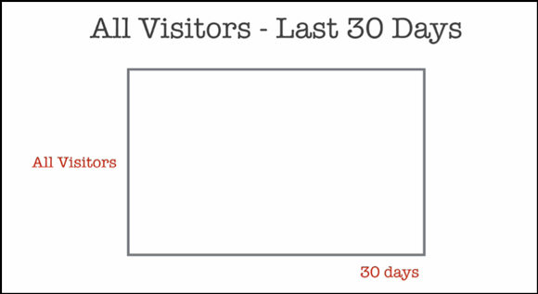
This is a typical remarketing list
http://www.digitalmarketer.com/remarketing-grid/
@thegoogleguy ← Mike Rhodes

Slide 73
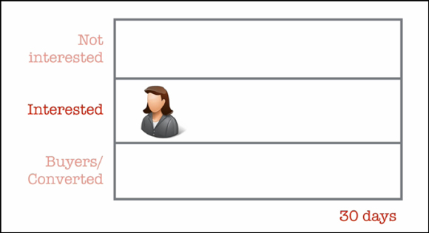
However, there is an important segment of people we want to influence
http://www.digitalmarketer.com/remarketing-grid/
@thegoogleguy ← Mike Rhodes

Slide 74
How do we know who’s interested?
The only real way to #measure the “why” behind people’s actions is to ask them. Qualitative data #ftw.
However, quantitative data can allow us to make inferences into visitor intent.
Let’s brainstorm some examples:

Slide 75
Micro-conversions as indication of interest and potential value
Add to cart
Add to wishlist
Viewed video
Began filling out a form
Compared items / options
Live chat
Discover your own…

Slide 76
Sessions of customers who did not purchase during that session

Slide 77
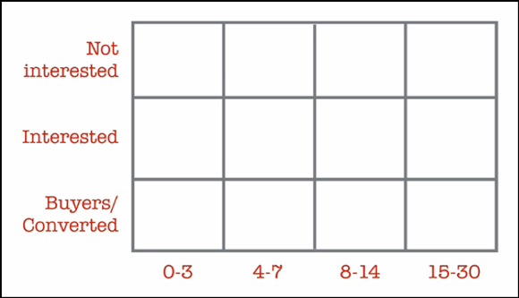
Let’s break that down into time cohorts
http://www.digitalmarketer.com/remarketing-grid/
@thegoogleguy ← Mike Rhodes

Slide 78
Choose appropriate membership durations for your remarketing lists

Slide 79
Choose appropriate membership durations for your remarketing lists

Slide 80
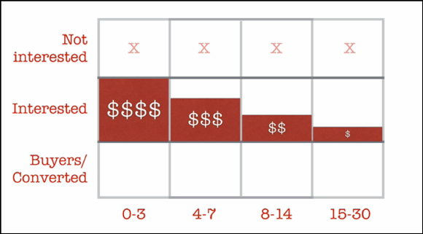
Time Decay Decreasing Bid Modifiers
http://www.digitalmarketer.com/remarketing-grid/
@thegoogleguy ← Mike Rhodes

Slide 81
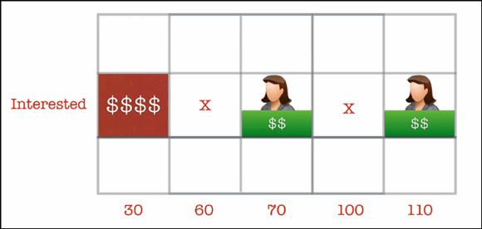
Fight Banner Fatigue
http://www.digitalmarketer.com/remarketing-grid/
@thegoogleguy ← Mike Rhodes

Slide 82
Targeting Using Time Cohorts
Industries
Occasions
Flowers
Travel Industry
Insurance
Car Repair
Clothing
Servicing Appliances
Pet Supplies
Office Supplies
Cleaning Supplies
Birthdays
Births
Anniversaries
Holidays
@analyticsninja

Slide 83
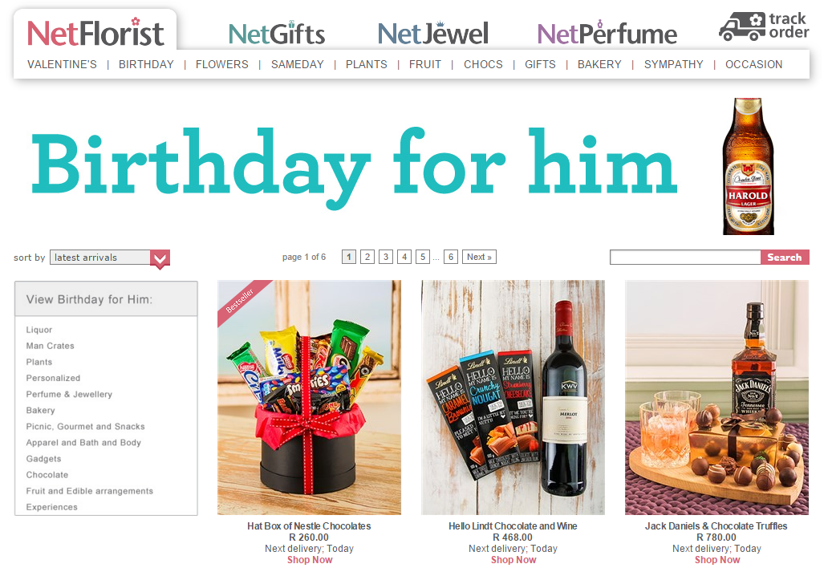

Slide 84
What do we know about my purchase?
Gender of person with birthday
Type of product purchased
When the buyer was shopping for the birthday
Amount spent

Slide 85
Remarketing Action Items
Add user to relevant audience lists with year+ list duration.
Add a negative list of ~320days to begin showing relevant birthday ads as the date approaches again.

Slide 86
How to remarket to parents

Slide 87
He’s 4 months old

Slide 88
Measuring people’s actions on the website can be used to build remarketing lists

Slide 89
What do we know about my purchase?
Age of child
Gender of child
Type of product purchased
How silly the parents are willing to make the kid look by having matching outfits all covered with panda bears and crap like that

Slide 90
How should you target me?
For next two months, show me age appropriate product cross sells
Between 3-6 months from now, show me more products that are age appropriate (like shoes because he’s going to start walking).
Same goes for 6-12 months…
After 12 months sell my customer information to a predatory loan shark since I’ll probably be looking for some financial assistance

Slide 91
RECAP!

Slide 92
RECAP!
Plan your data collection. Document it well. Mission Driven segmentation capabilities will open the doors for ad-hoc insights.
Two types of segmentation.
Use the ABCs in all your custom reports, and include horizontal funnels.
Hit Level Segmentation reveals INTENT.

Slide 93
RECAP!
USERS not sessions for most of your segments
Integrating profit metrics into your analytics tool will make sure you’re not misled by metrics such as “revenue” or “conversion rate”.
Measure the true value of your media spend using attribution modeling and multichannel funnel reports.

Slide 94
RECAP!
Bid more aggressively on products and product categories with a high propensity for purchase (good “look to book” ratios).
Retarget the “interested” people on your site with time decay bid modifiers for RLSAs and Display.
For longer campaigns, use an “on/off” approach with adds to combat banner fatigue (and set impression caps!)

Slide 95
RECAP!
Segment, segment, segment, segment, segment, segment, segment, segment, segment, segment, segment, segment, segment, segment, segment, segment, segment, segment, segment, segment, segment, segment, segment, segment, segment, segment, segment, segment, segment, segment, segment, segment, segment, segment, segment, segment, segment, segment, segment, segment, segment, segment, segment, segment

Slide 96
Learn More At…
ANALYTICS-NINJA.COM
Yehoshua Coren Email: ninja@analytics-ninja.com Twitter: @analyticsninja

